Slide 1
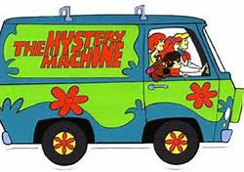
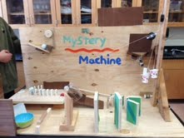
The Mystery Machine
Created by
Kyle Rockwell, Ronan Shaffer, Dalton Scheiner, Emmy Nam

Slide 2
Goal of Project
The point of constructing this project was to use physics and simple machines to execute a very simple task.

Slide 3
Step One
Wheel and Axle pulls up wedge
Mechanical Advantage=2
We can use half the force to lift the wedge when using the machine, but it takes twice the distance.

Slide 4
Step Two
Ball Rolls down Incline Plane
Momentum=0.096 kg x m/s
Find the velocity and mass of object first in order to calculate momentum
Velocity=distance/time

Slide 5
Step Three
Ball hits lever and the marble goes up
Mechanical Advantage=2.73
Golf ball’s mass is greater so the marble goes farther

Slide 6
Step Four
Marble lands in funnel and goes down
Work=0.024J
How far the marble goes up

Slide 7
Step Five
Marble collides with domino
Elastic Collision-the majority of energy is transferred
Some energy was lost due to friction

Slide 8
Step Six
Cup raises pulley
Mechanical Advantage=1
Goes the same amount of distance, but only needs a small amount of force

Slide 9
Step Seven
Empty cup sets off zip line
Change of kinetic energy to potential energy=0.031J
Enough energy is transferred to raise cup

Slide 10
Step Eight
Zip line hits dominos
Kinetic energy=0.081J
Potential energy is transferred to kinetic energy when the object falls

Slide 11
Step Nine
Dominos knock car down incline plane
Work=0.04J
The car, which has a certain force, travels the distance of the incline plane.

Slide 12
Step Ten
Car hits progressively bigger dominos
Elastic collision-transfers the majority of the energy when two objects hit each other
Some energy is lost due to friction

Slide 13
Step Eleven
Cup pours Scooby Snacks into bowl
Work=0.082J
Calculated the distance a certain object moved

Slide 14
Simple Machines Used
Wheel and Axle
Wedge
Lever
Pulley
Incline Plane

Slide 15
Project History
Spent 16 hours constructing and building
Took 6 hours to put together calculations and measurements
Changed the majority of the original steps

Slide 16
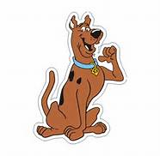
Progress of Machine
Adjusted certain steps many times in order to have accurate results
Changed end goal
Got rid of entire ideas because they were too complex and did not work well

Slide 17
Major Changes
Took two days to adjust the lever properly(4 hours)
Added zip line and dominos
Used wheel and axel instead of screw
Changed our end goal

Slide 18
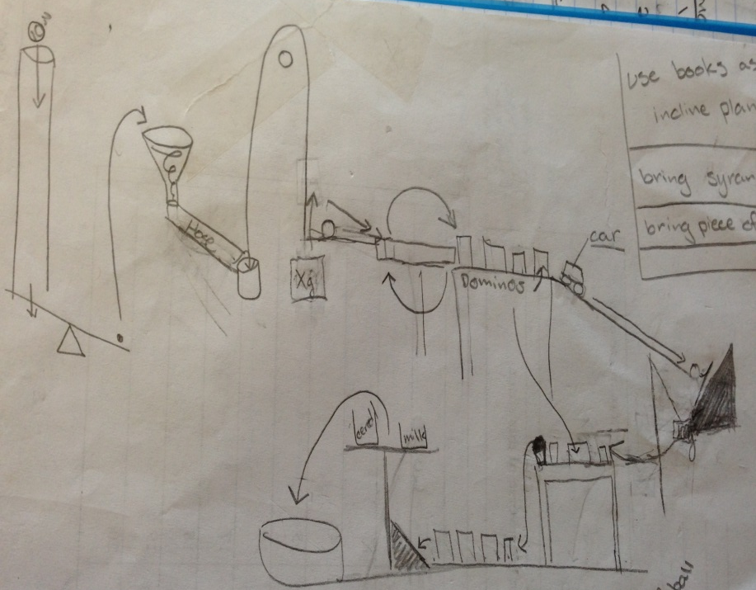
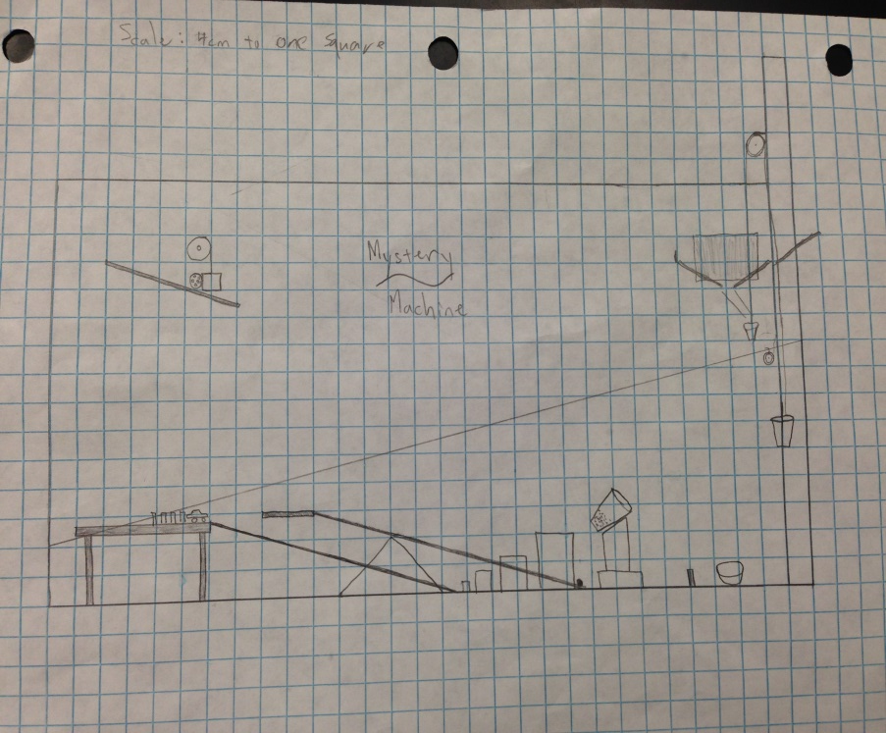
Changes of Design
Original
Final
PICTURE OF SKETCH
FINAL PICTURE
Scale: 1 square:4 cm

Slide 19
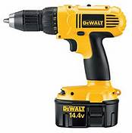
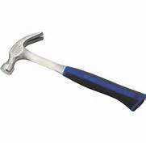
Tools Used
Power drill
-Used to make starter holes and to install screws
Hammer
-To drive nails
Hot glue gun
-To attach things in place

Slide 20
Materials
Pulleys, golf ball, marble, dominos, pieces of string, plastic cups and bowls, nails, screws, wood and hot glue, wheels, and lots of wood!
We built a lot of our own machines, such as the lever, funnel, and wood dominos.

Slide 21
Video of Completed Machine
Visit YouTube video
http://www.youtube.com/watch?v=hlEs-sJre0A&feature=youtu.be

